Slide 1
PVC Pipe: Common Misconceptions and Questions
PRESENTED BY:
Brooks Ryan, E.I.T.
Graduate Engineer
11/14/23

Slide 2
Agenda
History and Overview of PVC Pipe
PVC Sewer Pipe
Longevity and Resilience
PVC Pressure Pipe
Health and Sustainability
Summary & Additional Resources

Slide 3
Uni-bell pvc pipe association
Founded in 1971 as a non-profit organization
Authoritative source of information on PVC pipe
Serves the engineering, regulatory, public health and standardization communities.
Provide users with information on the design and installation of PVC pipe.
Produces technical publications and is active in standards-development organizations.
Conducts research in the areas of buried pipe deflection, pipe longevity, and cyclic performance.

Slide 4
PVC Pipe Standards
PVC PIPE HISTORY
ASTM D2241 published in 1960s
AWWA C900 published in 1970s
ASTM D3034 published in 1970s
AWWA C905 published in 1980s
ASTM F679 published in 1980s
AWWA C907 published in 1991
AWWA C909 published in 1998

Slide 5
PVC Pipe Standards
AWWA Standards
C900-16
C907-17
Polyvinyl Chloride (PVC) Pressure Pipe and Fabricated Fittings, 4 In. Through 60 In. (100 mm Through 1,500 mm)
C909-16
Injection-Molded Polyvinyl Chloride (PVC) Pressure Fittings, 4 In. Through 12 In. (100 mm Through 300 mm), for Water, Wastewater, and Reclaimed Water Service
Molecularly Oriented Polyvinyl Chloride (PVCO) Pressure Pipe, 4 In. (100 mm) and Larger
C605-13
Underground Installation of Polyvinyl Chloride (PVC) and Molecularly Oriented Polyvinyl Chloride (PVCO) Pressure Pipe and Fittings

Slide 6
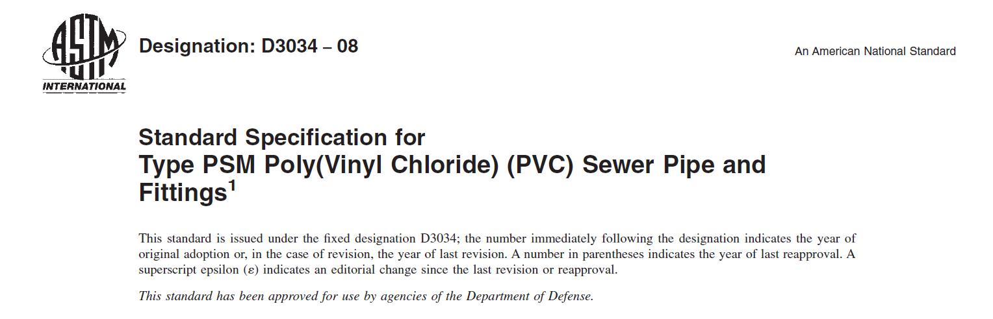
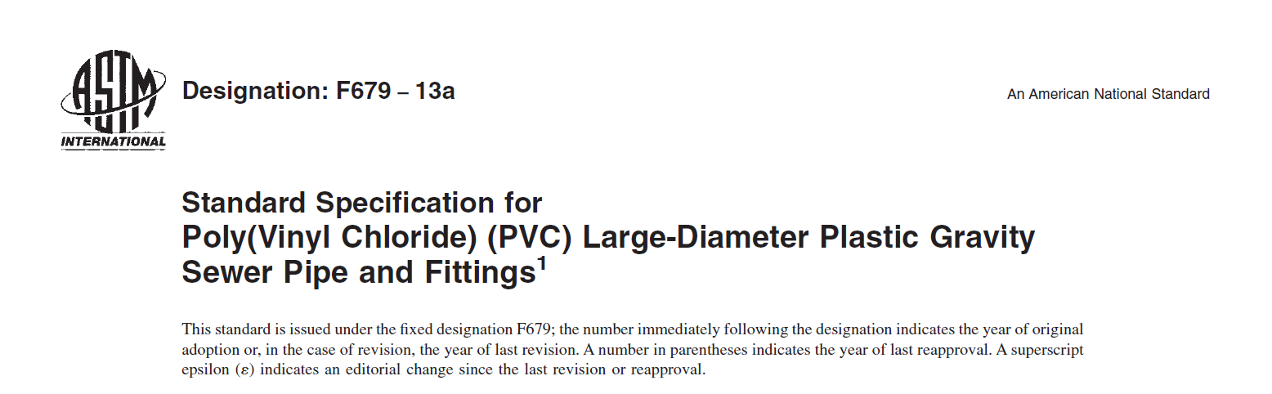
PVC Pipe Standards
ASTM Standards
ASTM D3034
ASTM F679
3” – 15” Solid Wall
18” – 60” Solid Wall

Slide 7
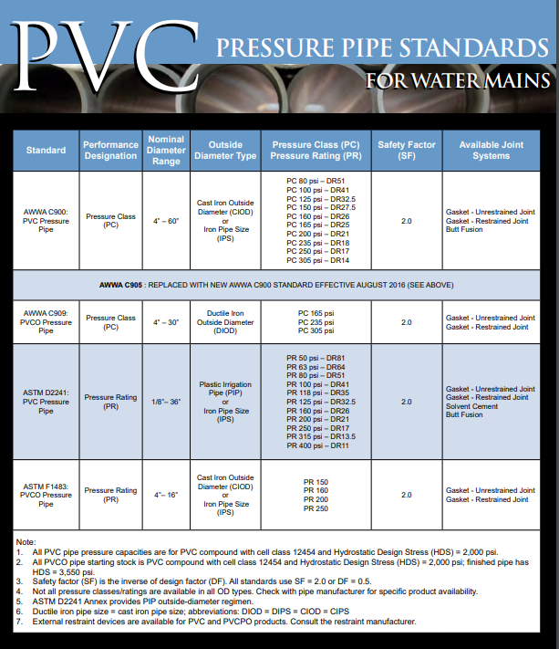
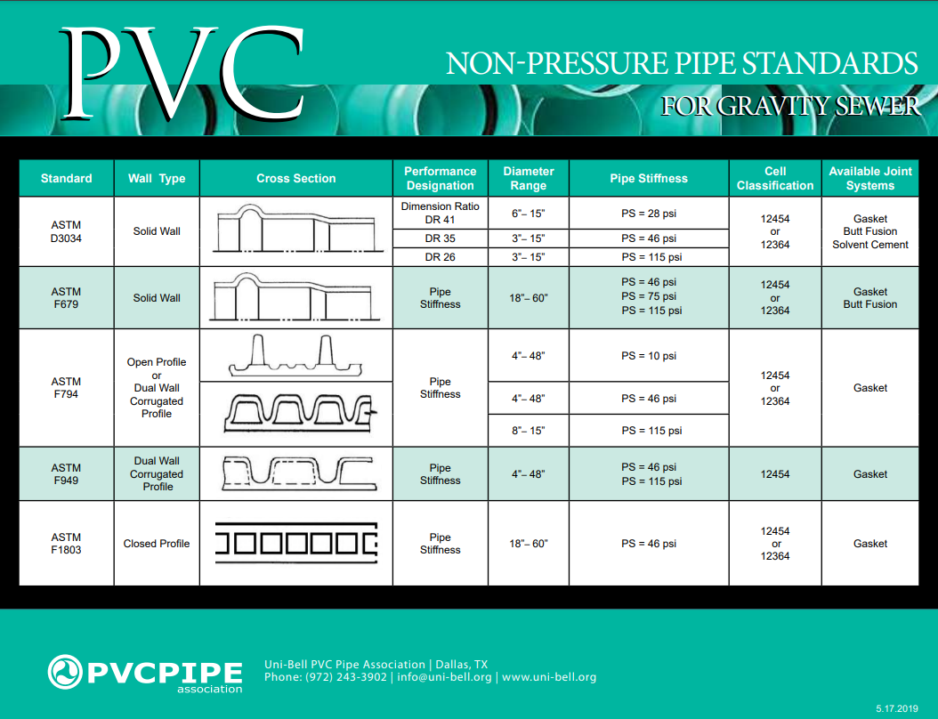
PVC Pipe Standards

Slide 8
Agenda
History and Overview of PVC Pipe
PVC Sewer Pipe
Longevity and Resilience
PVC Pressure Pipe
Health and Sustainability
Summary & Additional Resources

Slide 9
PVC Pressure Pipe
Pressure Design: PVC Pipe
DR | Pressure Class (psi) | WP+P_{RS} (psi) | WP+ P_{OS} (psi)
51 | 80 | 80 | 128
41 | 100 | 100 | 160
32.5 | 125 | 125 | 200
26 | 160 | 160 | 256
25 | 165 | 165 | 264
21 | 200 | 200 | 320
18 | 235 | 235 | 376
14 | 305 | 305 | 488
Working (WP)
Recurring (Cyclic) Surge (P_{RS})
Occasional Surge (P_{OS})
Hydrostatic Test (P_{FT})
WP ≤ PC
WP + P_{RS} ≤ PC
WP + P_{OS} ≤ 1.6 x PC
P_{FT} ≤ 1.5 x WP ≤ PC
If sustained operating temperatures exceed 73°F, a thermal derating factor should be applied.

Slide 10
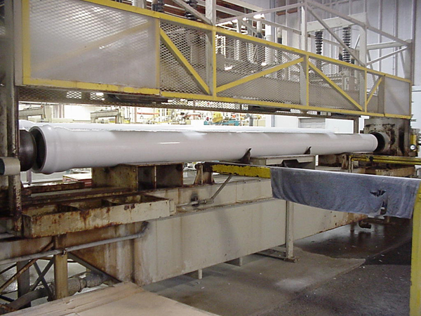
PVC Pressure Pipe
Pressure Test
DR | Pressure Class (psi) | Hydrostatic Pressure Test (psi) | 1000 Hour Sustained Pressure Test (psi) | Quick Burst Pressure Test (psi)
25 | 165 | 330 | 350 | 535
21 | 200 | 400 | 420 | 630
18 | 235 | 470 | 500 | 755
14 | 305 | 610 | 650 | 985

Slide 11
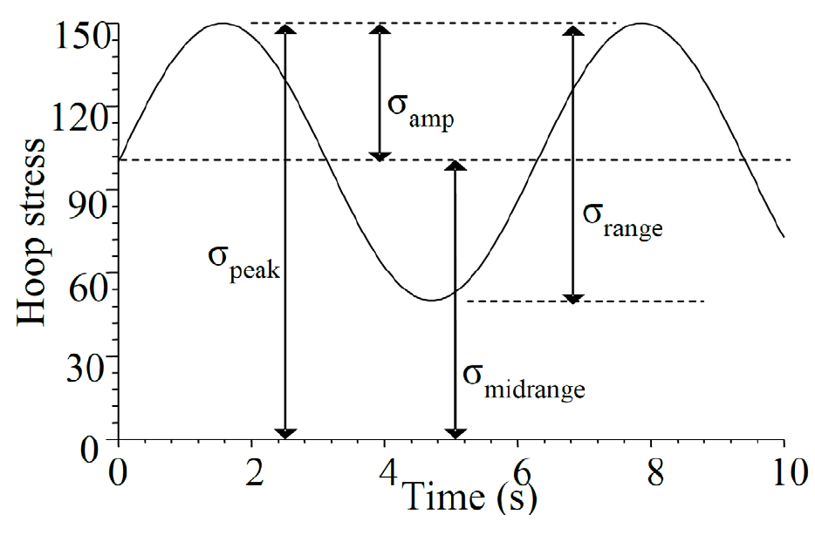
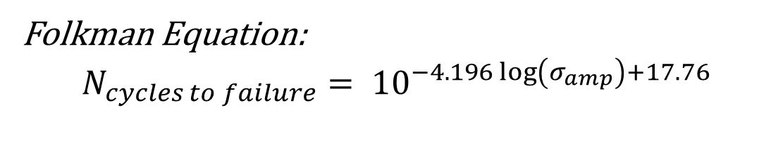
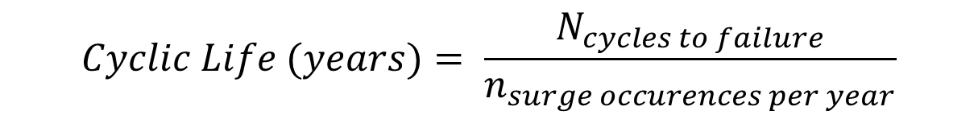
PVC Pressure Pipe
CYCLIC LIFE
Cyclic Life Check should be done for high frequency surge applications (force mains, irrigation)
Folkman Equation:
$$N_{cycles to failure}= {10}^{−4.196\log\left(σ_{amp}\right)+17.76}$$
$$Cyclic Life (years)= \frac{N_{cycles to failure}}{n_{surge occurences per year}}$$

Slide 12
PVC Pressure Pipe
CYCLIC LIFE
Testing/History shows PVC pipe has excellent fatigue resistance
  Used since 1970’s
  Over 40,000 miles in service today.
Cyclic Life Check is just to ensure pipe meets specified design life (i.e. 100 years)
As with any pipe material, proper installation is key

Slide 13
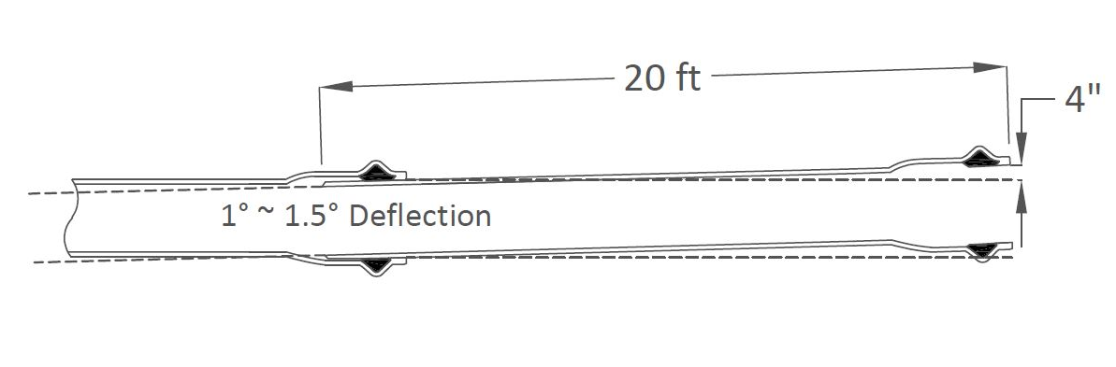
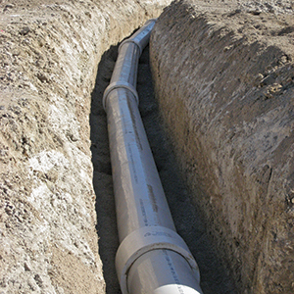
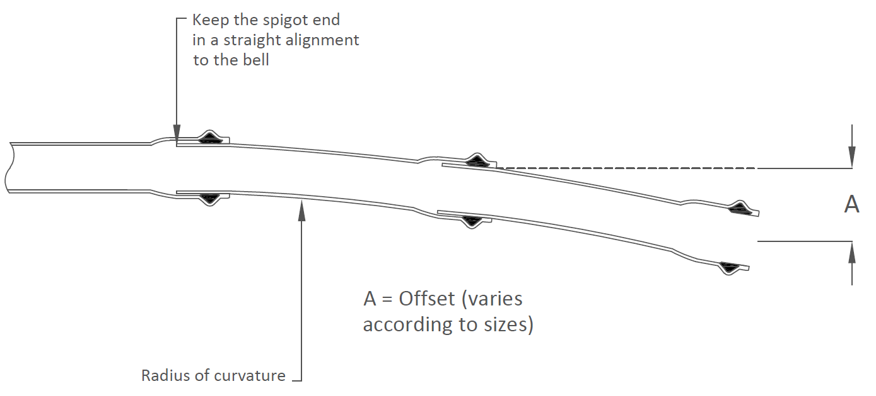
PVC Pressure Pipe
Changes in Direction
Joint Deflection
Longitudinal Bending
Within limits of Contractor’s Guide for Installation of Gasketed PVC Pipe
1 to 1.5° Joint Pull Typically Available
Fabricated Fitting
Available in 1-5° Sweeps or Angled Couplings
Fittings for angles over 5° (5.625°, 11.25°, 22.5°, 45°, 90°)
Notes:
1⁰ deflection on a 20’ joint equals an offset of 4”, a radius of 1,146’;
1⁰ deflection on a 14’ joint equals and offset of 2 ¾” and a radius of 802’;
1⁰ deflection is equivalent to a change of slope of 1.75 %

Slide 14
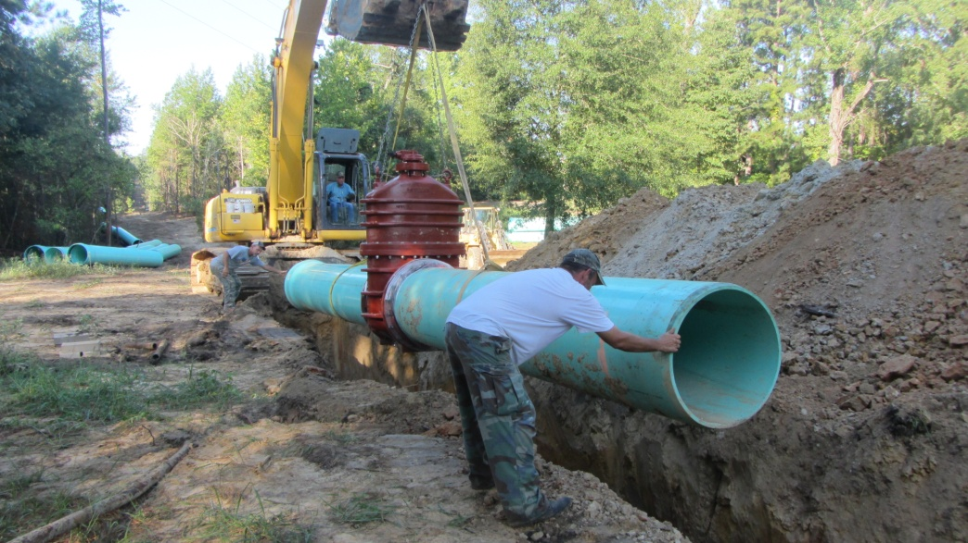
PVC Pressure Pipe
Transition to PVC from DI
Compatibility with Installed DI Pipe
  - Same OD
  - Same fittings, valves and appurtenances
  - Same manufacturers producing fittings, valves and appurtenances
  - Same distributors providing all non-pipe items necessary for pipeline
  Interchangeable parts for typical repairs

Slide 15
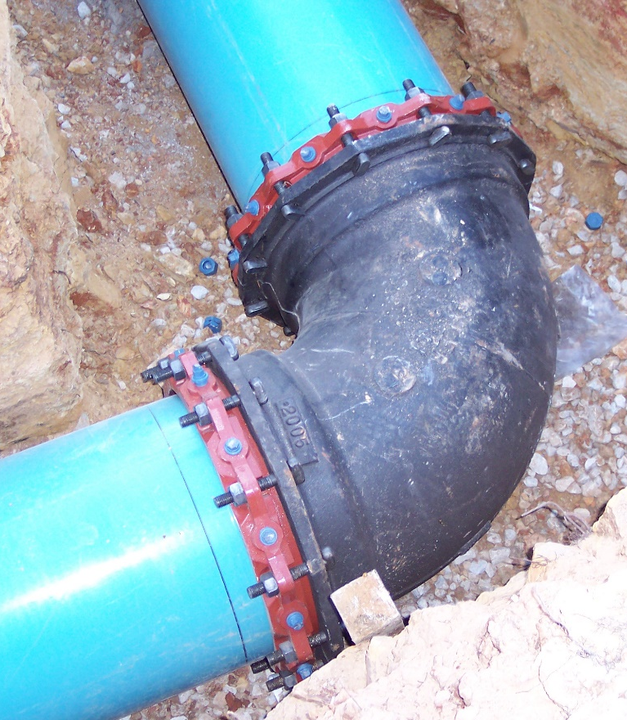
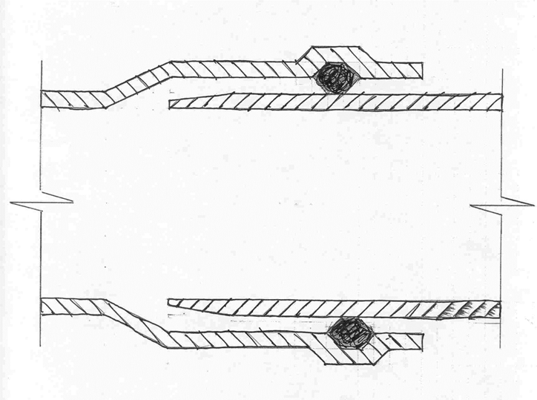
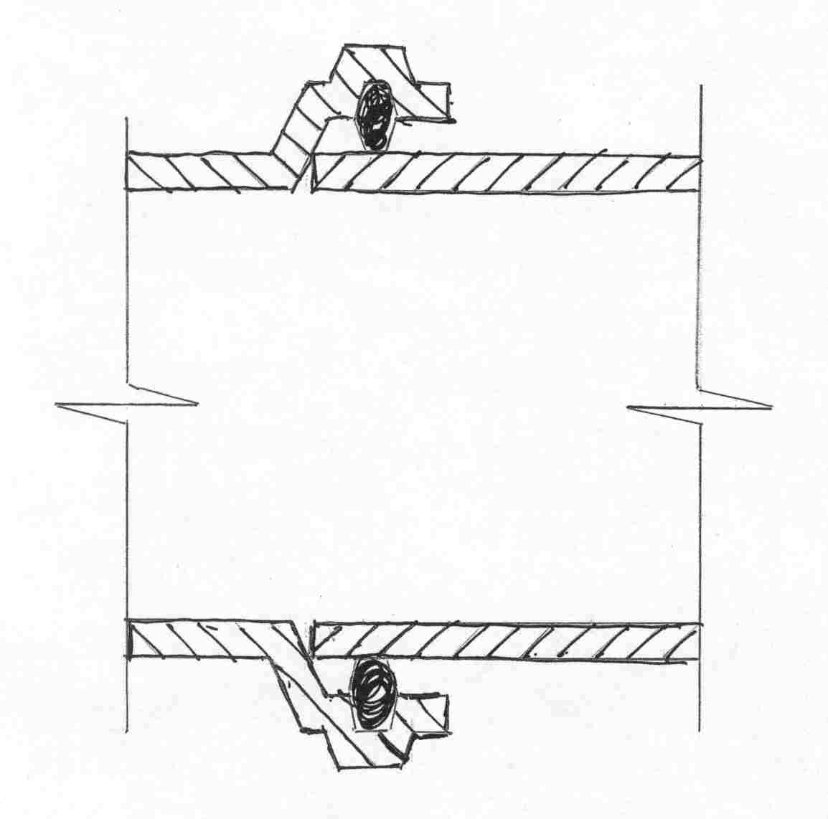
PVC Pressure Pipe
Ductile Iron Connections
PVC Pipe Bell
M.J. Fitting Bell

Slide 16
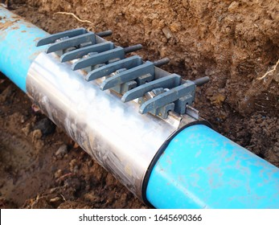
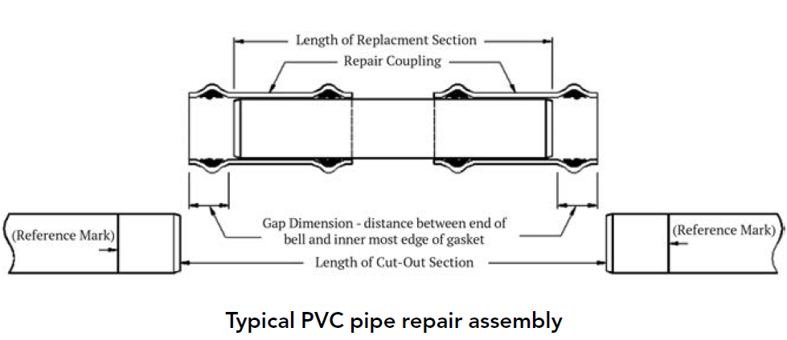
PVC Pressure Pipe
Pipe Repairs
Pipe with gouges or scratches should be addressed in accordance with AWWA C605
Repair clamps are utilized for localized damage; replacement sections are utilized for damaged areas that extend beyond a localized area
If one end of the existing pipe is a bell-end, only one repair coupling is required.
Repairs can be made with clamps or with a replacement section and couplings
Replacement repair procedure for PVC pipe is outlined in Contractor’s Guide

Slide 17
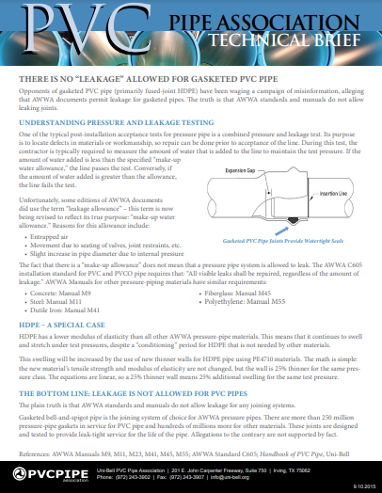
PVC Pressure Pipe
Leak-Free Joints
Pressure and leakage test includes “make-up water allowance” for entrapped air, movement of joints, and slight increase in I.D. due to internal pressure
If the allowance is exceeded the test fails, the joints are not allowed to leak as part of the test

Slide 18
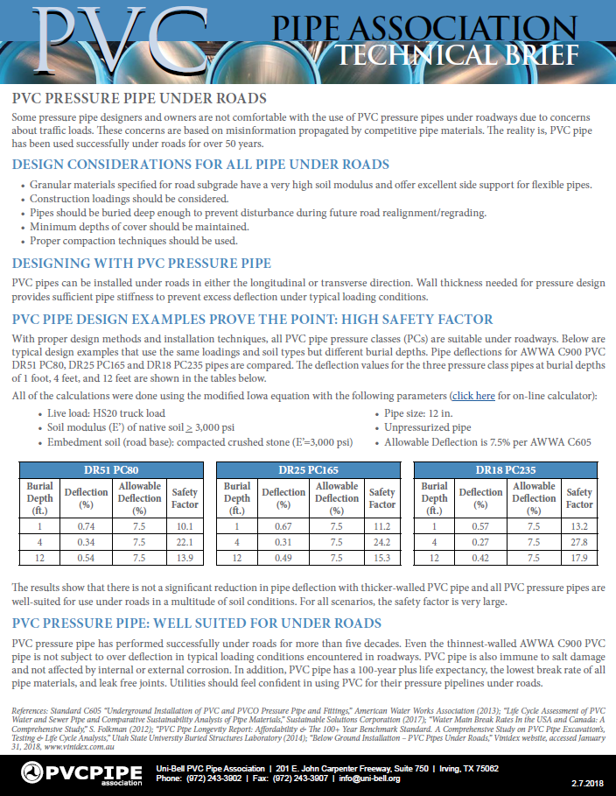
PVC Pressure Pipe
“PVC Pressure Pipe Under Roads”
Granular materials specified for road subgrade have a very high soil modulus and offer excellent side support for flexible pipes
Wall thickness needed for pressure design provides sufficient pipe stiffness to prevent excess deflection under typical loading conditions
Casing not necessary with proper backfill and compaction
Construction loadings should be considered

Slide 19
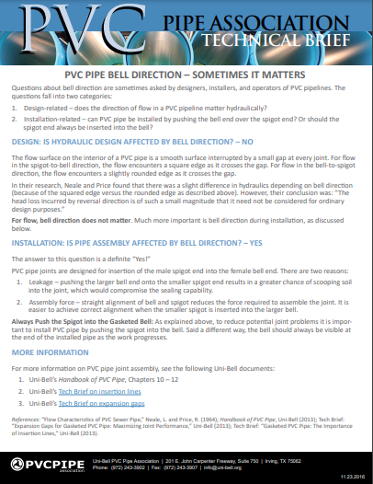
PVC Pressure Pipe
Bell Direction
Bell direction does not affect hydraulic performance of PVC pipe
Spigot end should be inserted into the bell end
Bell direction should be taken into consideration during installation

Slide 20
Agenda
History and Overview of PVC Pipe
PVC Sewer Pipe
Longevity and Resilience
PVC Pressure Pipe
Health and Sustainability
Summary & Additional Resources

Slide 21
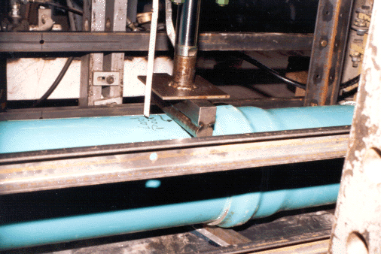
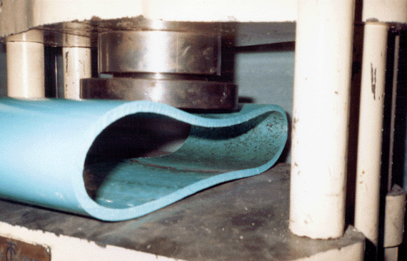
PVC Sewer Pipe
Testing
Joint Test – Joints are Pressure (25 ft. Head) and Vacuum (-10.8 psi) tested while joint is undeflected and at 5% deflection
Flattening Test – Pipe is flattened between parallel plates up to 60% of Diameter without splitting or cracking

Slide 22
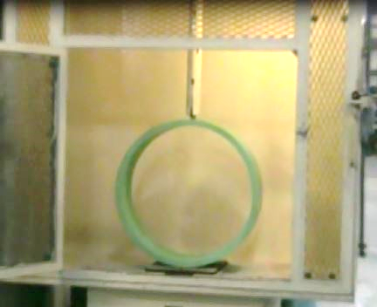
PVC Sewer Pipe
Impact Test
Impact test performed under ASTM D2444
Pipe must withstand minimum 220 ft-lb impact strength
Falling Tup
Pipe Sample

Slide 23
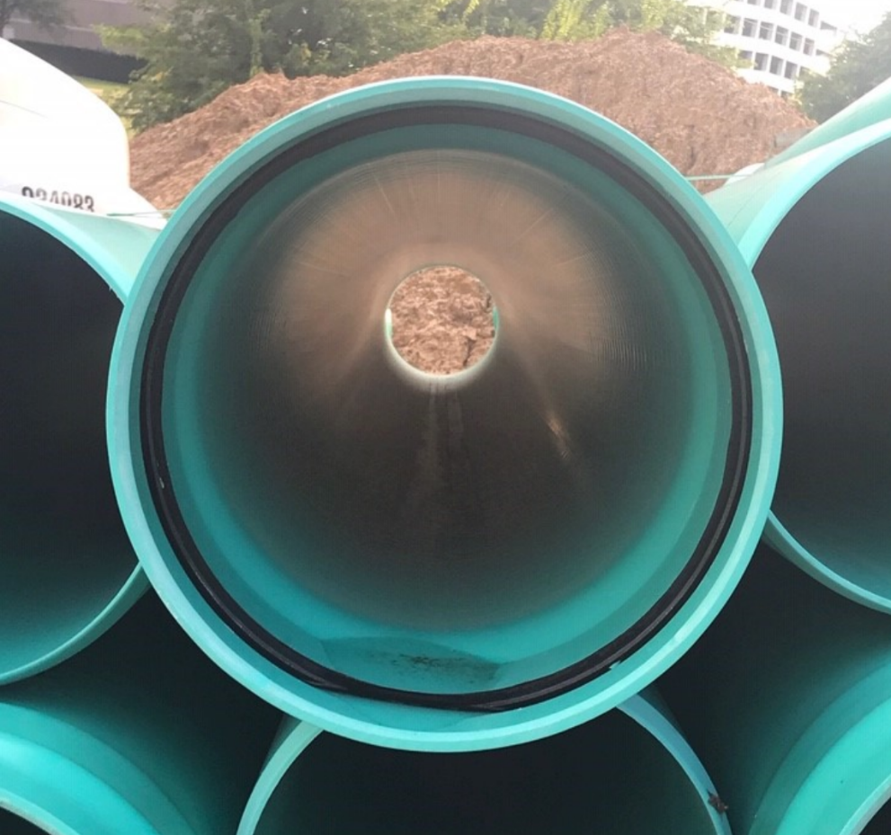
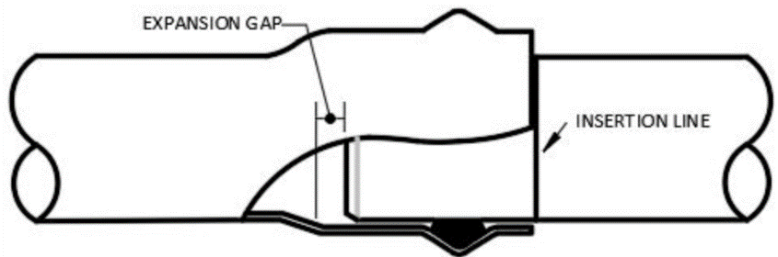
PVC Sewer Pipe
Misconceptions
C-900 Gaskets VS 3034/F679 Gaskets
PVC Gravity Sewer joints regarding infiltration/exfiltration
PVC Gravity Sewer Joints and internal pressure
Gasket

Slide 24

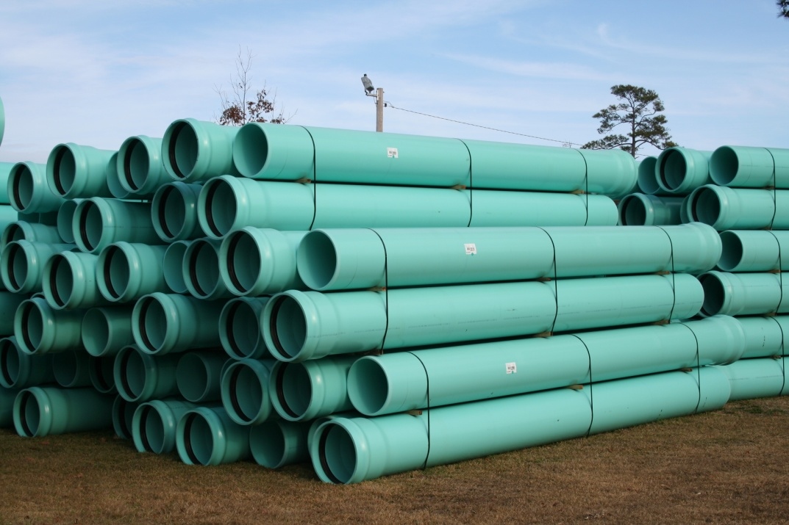
PVC Sewer Pipe
Biological Resistance
  Resistant to microorganism attacks
  Smooth walls resist colony growth
  Bacterial byproducts in sewers are not a factor

Slide 25
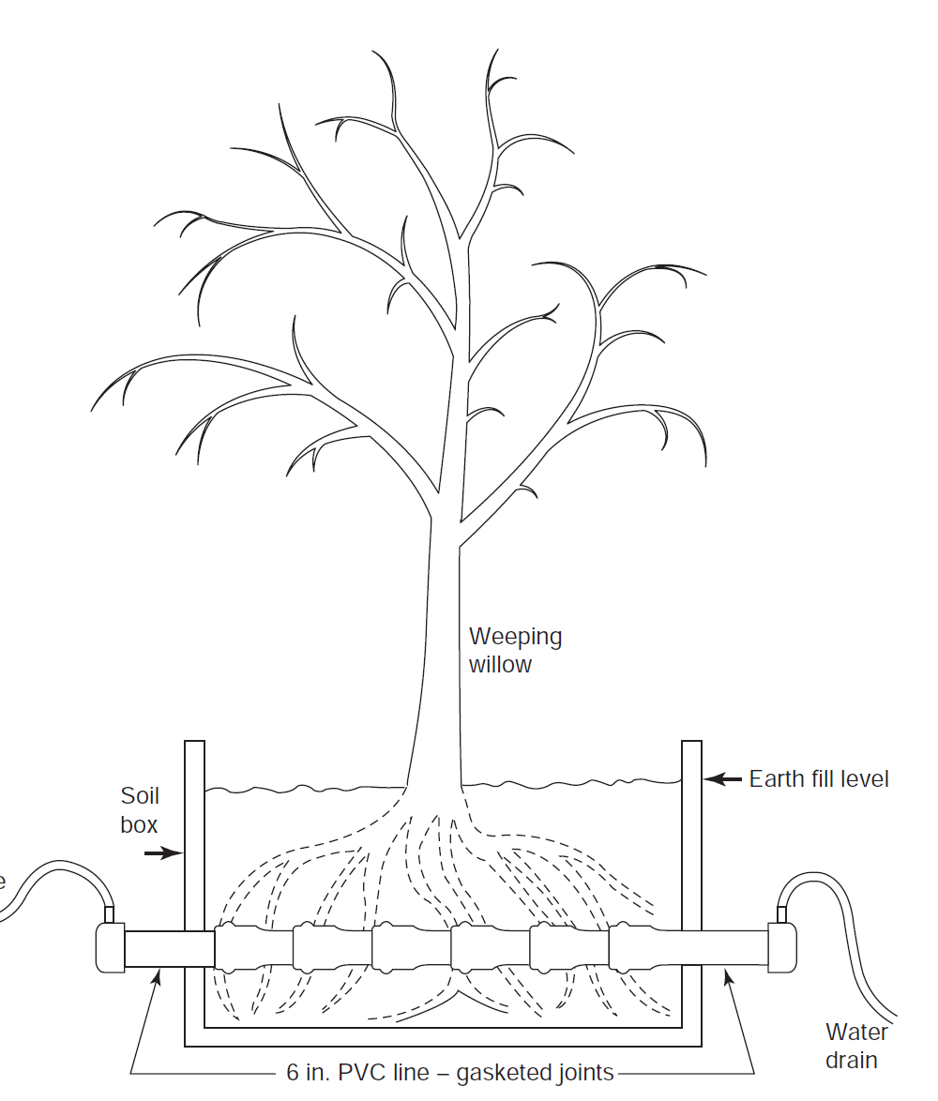
PVC Sewer Pipe
Roots and joint integrity
  Water-tight joints
  No leakage allowed
  Gasket and joint prevent infill and exfiltration

Slide 26
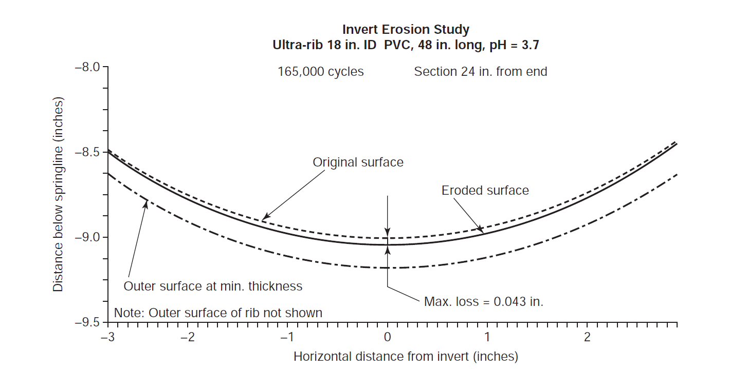
PVC Sewer Pipe
Abrasion and weathering
  PVC is commonly used in gravity and storm sewer applications worldwide
  Smooth but strong walls resist inner wall degradation over time
  Aggregate slurry tests of PVC to 260,000 cycles

Slide 27
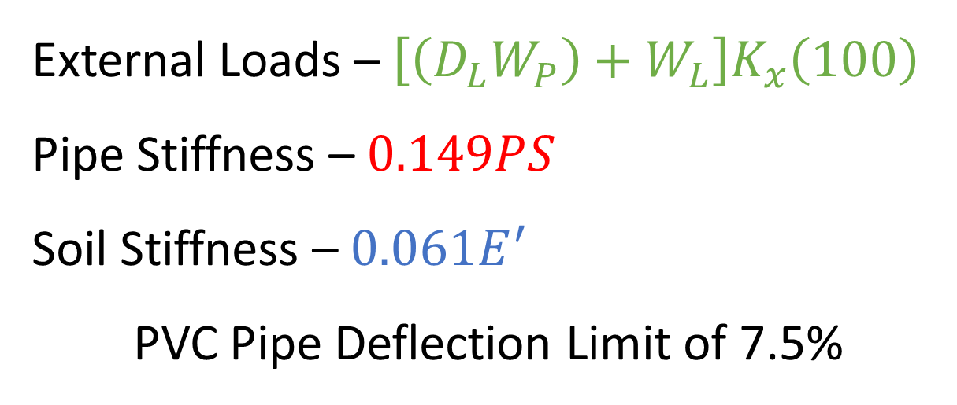
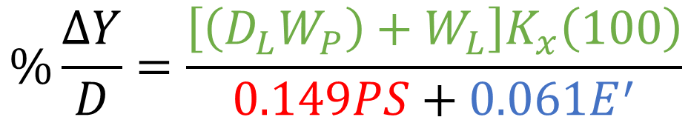
External Load
Iowa Formula
$$\%\frac{∆Y}{D}=\frac{\left[\left(D_{L}W_{P}\right)+W_{L}\right]K_{x}\left(100\right)}{0.149PS+0.061E^{′}}$$
External Loads – $\left[\left(D_{L}W_{P}\right)+W_{L}\right]K_{x}\left(100\right)$
Pipe Stiffness –$0.149PS$
Soil Stiffness – $0.061E^{′}$
PVC Pipe Deflection Limit of 7.5%

Slide 28
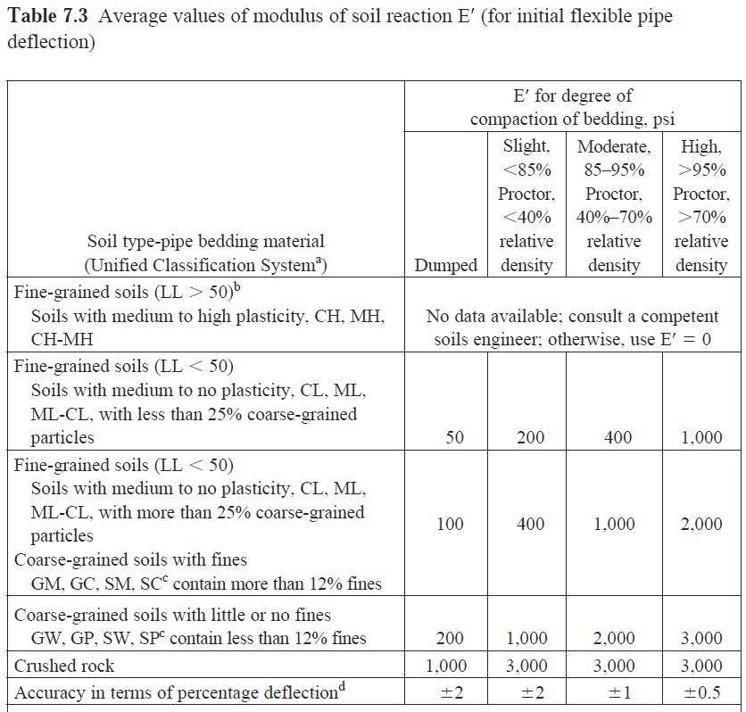
PVC Sewer Pipe
Bedding - E’_{b} Table in Handbook of PVC Pipe

Slide 29
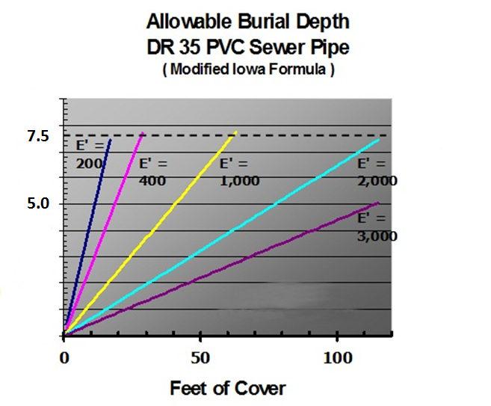
PVC Sewer Pipe
DEEP BURY ALLOWABLE BURIAL DEPTH
PS 46,
Pipe Deflection (%)
Fig. 7.13 Allowable burial depth for DR 35 PVC sewer pipe.

Slide 30
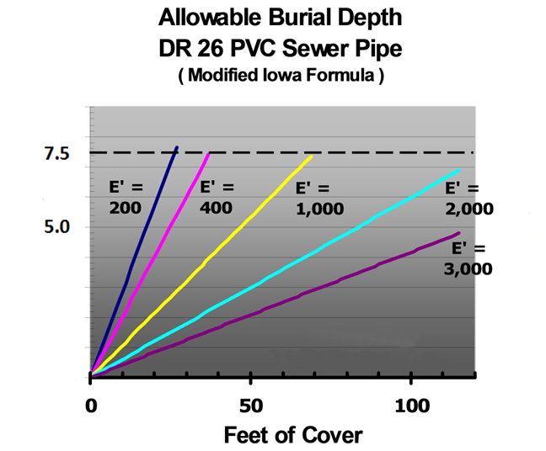
PVC Sewer Pipe
DEEP BURY ALLOWABLE BURIAL DEPTH
PS 115,
Pipe Deflection (%)
DR 26
Fig. 7.14 Allowable burial depth for DR 26 PVC sewer pipe.

Slide 31
PVC Sewer Pipe
Design - example
60” ASTM F679 PS 46 pipe, 30’ cover, E’_{b} = 2000 psi
Soils Info:
Unit wt. of backfill = 120 lbs/ft³
Embedment will be GW @ 95% SPD
E’_{b} = 2,000 psi
30’
30”
61.61”
30”

Slide 32
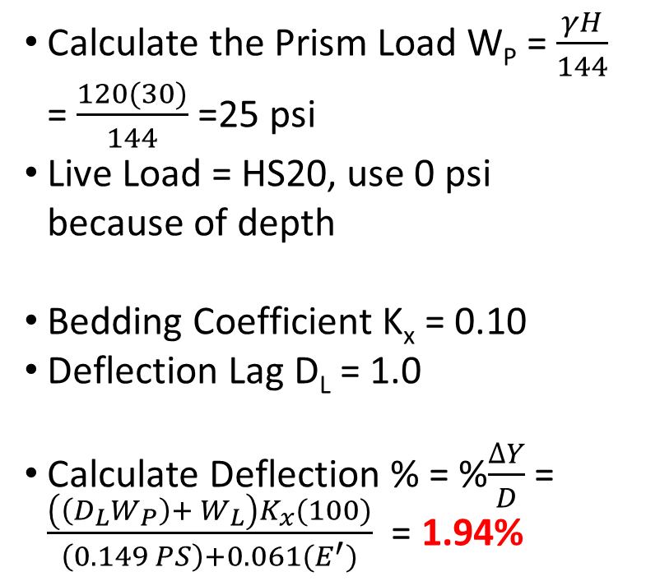
PVC Sewer Pipe
Design - example
60” ASTM F679 PS 46 pipe, 30’ cover, E’_{b} = 2000 psi
Calculate the Prism Load W_{P} = $\frac{γH}{144}$ = $\frac{120(30)}{144}$ =25 psi
Live Load = HS20, use 0 psi because of depth
Bedding Coefficient K_{x} = 0.10
Deflection Lag D_{L} = 1.0
Calculate Deflection % = %$\frac{∆Y}{D}$ = $\frac{\left(\left(D_{L}W_{P}\right)+ W_{L}\right)K_{x}(100)}{\left(0.149 PS\right)+0.061(E^{′})}$ = 1.94%
30’
30”
61.61”
30”

Slide 33
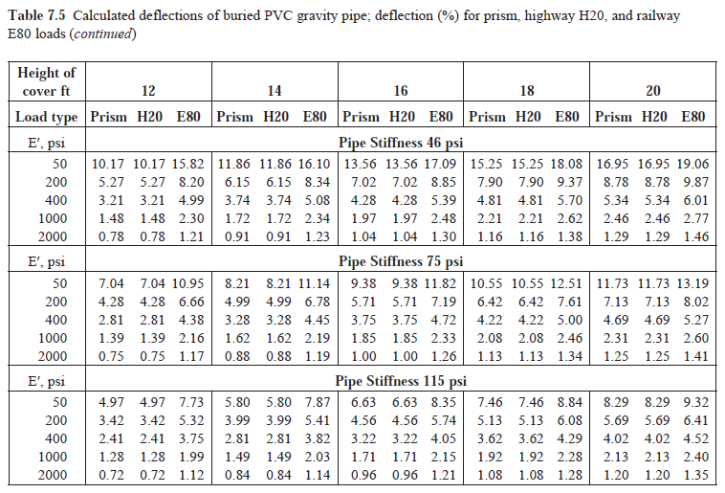
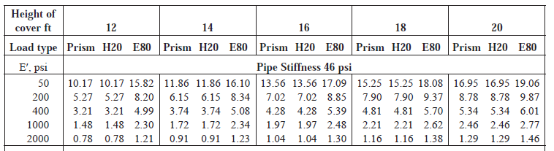
PVC Sewer Pipe
Handbook of PVC Pipe Deflection Table

Slide 34
Agenda
History and Overview of PVC Pipe
PVC Sewer Pipe
Longevity and Resilience
PVC Pressure Pipe
Health and Sustainability
Summary & Additional Resources

Slide 35
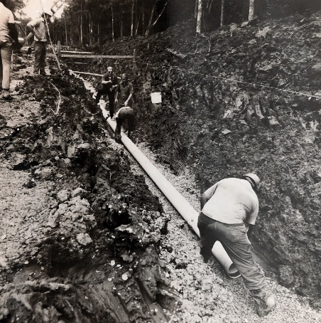
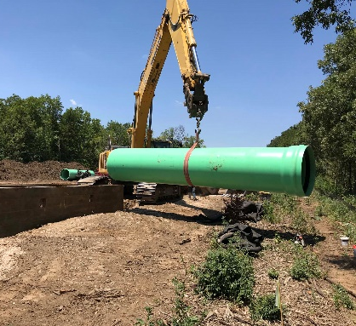
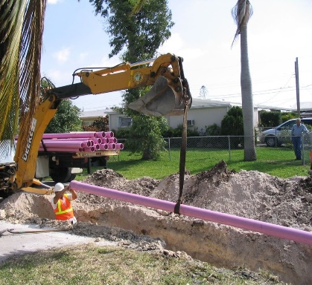
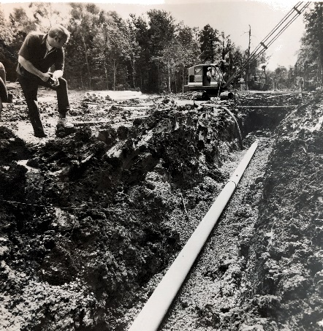
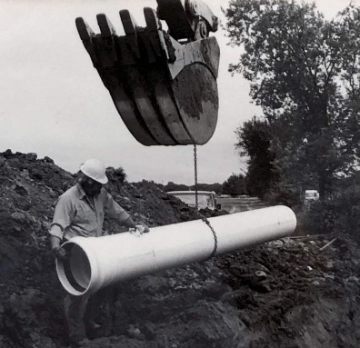
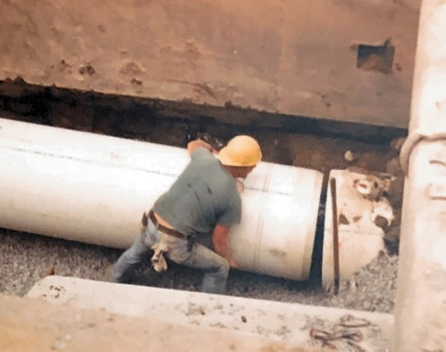
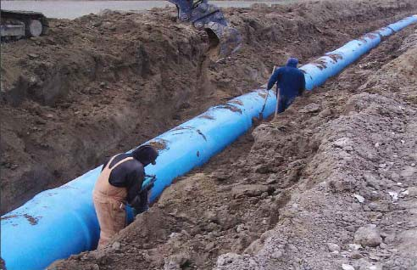
Longevity
History of PVC Pipe
PVC pipe originated in Europe
Most of the pipe is still in service today
PVC pipe was adopted later in North America
Today, PVC pipe is the number one material for water and sewer mains
Estimated 1.3 million miles of water mains in service in North America
Estimated 1.2 million miles of sewer mains in service in North America
Trial installations of PVC pipe were in 1934 (89 years)
large scale installations in 1936 (87 years)
First installations of PVC pipe in 1952 (>70 years)

Slide 36
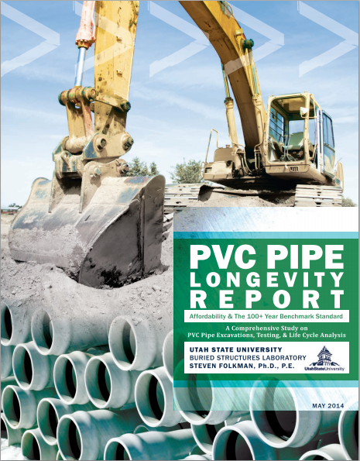
Longevity
2014 Longevity Report
Utah State University tested excavated PVC pipe ranging from 20-50 years old
Author also includes summaries of other PVC studies.
 | Sample 1 | Sample 2 | Sample 3
Size, DR | 4” SDR 21 | 4” SDR 21 | 24” DR 18
Use | Water | Water | FM
Year Installed | 1964 | 1987 | Early 1990’s
Years in Service | 49 | 26 | ~20
Pipe Dimensions | Passed | Passed | Passed
Acetone Immersion | Passed | Passed | Passed
Pressure Test | Passed | Passed | Passed
This report concludes “The combination of research, testing, and analysis results in confirming a 100+ year benchmark standard for PVC pipes.”

Slide 37
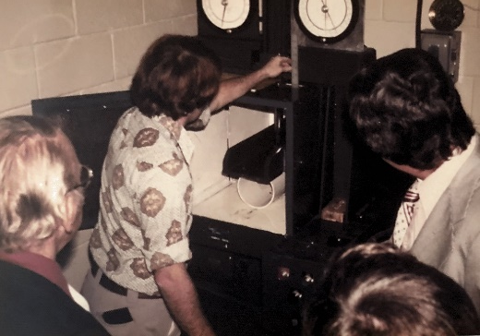
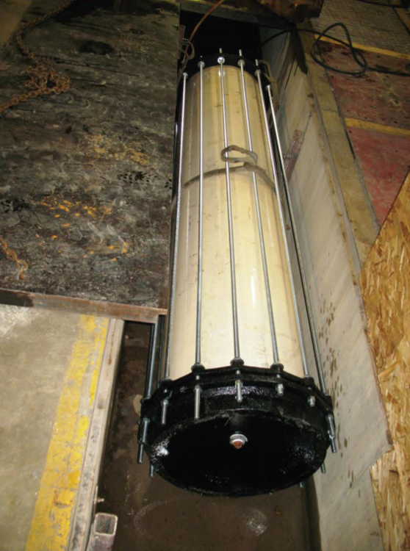
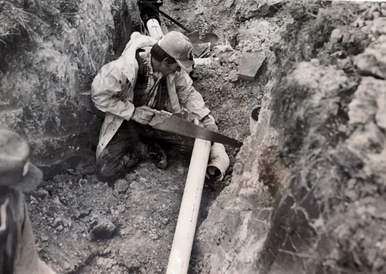
Longevity
Additional Studies
PVC Water Main Pipe 40 Years of Successful Service (Seargeant 2018)
40-year-old PVC pipe tested
Samples passed C900 requirements including quick burst pressure, joint pressure, extrusion quality
Expected Lifetime of Existing Water Distribution Systems (Breen 2006)
Tested some of the first PVC pipes installed in Germany
Tested pipe between 23 and 53 years old
Another 100 years of safe operation could be expected
70 Years of Experience with PVC Pipes (Hülsmann 2004)
Examined PVC pipe up to 46 years old
Testing included tensile, burst test, slow crack growth, impact, and fatigue
Concluded existing PVC tap water pipe systems in the Netherlands will operate for at least 100 years
Long-Term Performance Prediction for PVC Pipes (Burn 2005)
Funded by Water Research Foundation
Comprehensive review of methods to analyze expected life of PVC pipe
Reported that 100 years is a conservative estimate for properly designed and installed PVC pipe

Slide 38
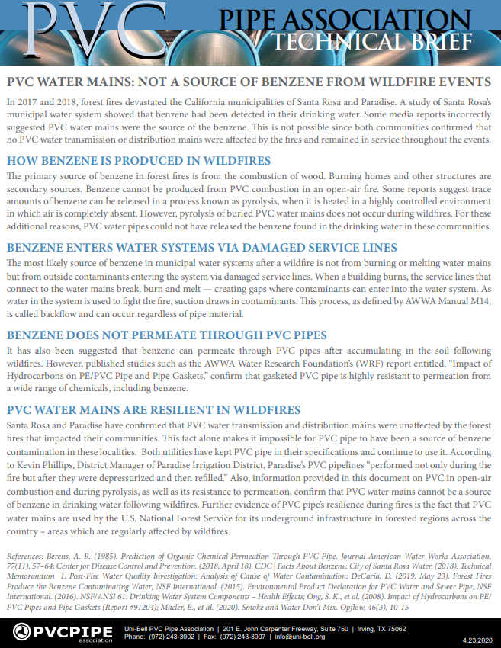
Resiliency
Wildfire
Notable wildfires in Santa Rosa and Paradise
PVC pipe water mains were unaffected in these systems
Contamination does not occur from buried PVC water mains, nor permeation
Case studies show the most likely source of contamination is from damaged service lines
Typically, water distribution mains are buried with at least 3’ of cover

Slide 39
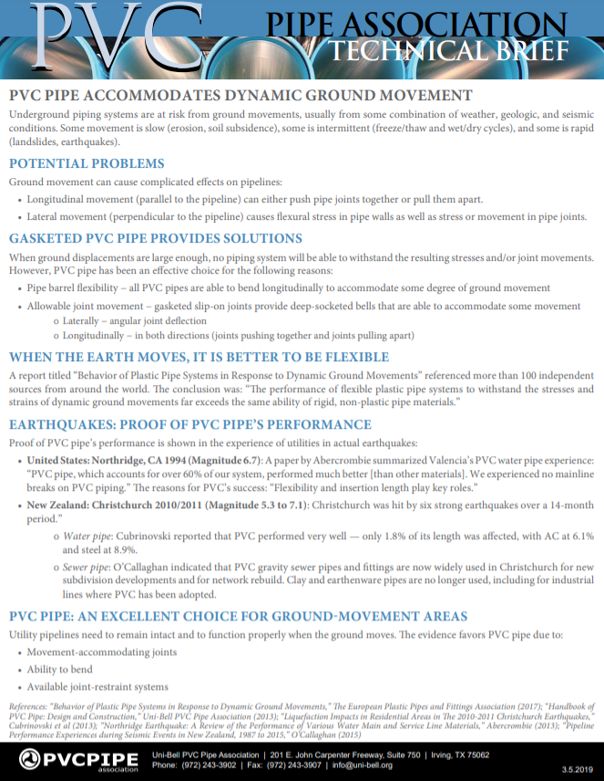
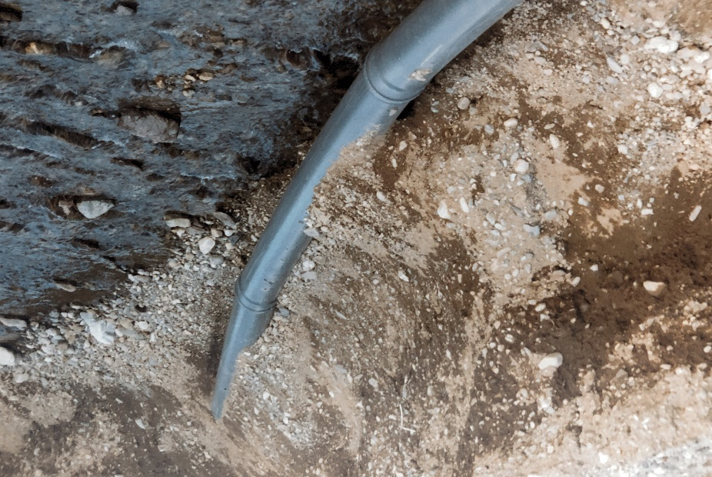
Resiliency
Ground Movement
Gasketed PVC pipe well suitable for ground movement
Provides axial flexibility as well as allowable joint movement

Slide 40




Resiliency
Seismic
Valencia Water Company – North Ridge, CA 1994
Magnitude 6.7
64% PVC pipe in their system
0 PVC mainline breaks
Reasons for PVC’s success: “Flexibility and insertion length play key roles.”
Christchurch, New Zealand 2010-2011
6 Earthquakes, Magnitude 5.3-7.1
Only 1% of PVC pipe length was affected

Slide 41

Resiliency
Freezing
  PVC pipe durability is not adversely affected by freezing
  Testing and case histories proved that even in clay, PVC could handle frost loadings
  Surrounding soil helps resist pipe expansion
  Overwhelmingly pipe of choice for Canada and Alaska
  Slight decrease in impact strength, not an issue once pipe is buried

Slide 42

Resiliency
UV Exposure
Colorants NOT meant to be color-fast; for identification ONLY
Fading is expected when exposed to Sun
Fading does NOT equal degradation
Fading occurs only in top 0.002” of pipe wall
Light-colored or white-colored pipe is okay
Brown/yellow/black-colored pipe signifies longer-term issues
Any light-colored opaque cover will prevent sun fading
PVC pipe is gray or white without colorants

Slide 43

Resiliency
Chemical degradation and permeation
  PVC is resistant to chemicals and chlorine
  Hydrocarbons are not a concern and will not permeate
  Gaskets and pipe
  Chemical resistance tables available in Handbook

Slide 44
Agenda
History and Overview of PVC Pipe
PVC Sewer Pipe
Longevity and Resilience
PVC Pressure Pipe
Health and Sustainability
Summary & Additional Resources

Slide 45

Sustainability
Life Cycle Assessment for PVC Pipe
Originally conducted in 2014 by Sustainable Solutions Corporation
Peer reviewed and certified
Quantified environmental impacts using ISO 14040 series
Investigated 7 PVC pipe products at each stage of the life cycle
Use 100-year life cycle period
Investigated the use-phase characteristics and pipe performance

Slide 46



Sustainability
2015 Environmental Product Declaration
LCA data was first published in 2015 in an Environmental Product Declaration (EPD)
EPD’s promote transparency to the public
Like a “food label” for building products
EPDs are developed based on the requirements of International Organization for Standardization (ISO) 14025

Slide 47

Sustainability
2023 Environmental Product Declaration
Analyzed 8 PVC pipe products at 35 manufacturing facilities
No known chemicals are released internally into the water system
No known toxicity effects occur in the use of the product
No known microplastics are associated with PVC pipe use
No known per- and polyfluoroalkyl substances (PFAS) are associated with PVC pipe production
Health and Safety findings
Industry realized 6% overall improvement in carbon footprint
20% reduction in electricity use during the extrusion process
66% reduction in water use during PVC pipe manufacturing

Slide 48

Sustainability
“Leaching” and Vinyl Chloride
  Leaching not an issue for PVC
  PVC produced from vinyl chloride monomer through polymerization
  NSF 61 requires regular testing of PVC pipe
  PVC pipe consistently tests “Non-Detect” for VCM

Slide 49
Agenda
History and Overview of PVC Pipe
PVC Sewer Pipe
Longevity and Resilience
PVC Pressure Pipe
Health and Sustainability
Summary & Additional Resources

Slide 50

Available Technical Resources
Website
www.pvcpa.org
Member Directory
Technical Resources
Contact Form
Notes:
Use the search bar to find something

Slide 51



Additional Resources
Installation Guides
Notes:
Updated installation guides

Slide 52



Available Technical Resources
Calculators
Cyclic-life calculator
External load design calculator
Internal pressure design calculator
Notes:
Use the search bar to find something

Slide 53

Available Technical Resources
Technical Briefs
Air Testing of Installed PVC Pipelines
Air Valves: Improving the Performance of Pressure Pipelines
Backfill Requirements for PVC Pressure and Gravity Pipes
Changing Direction: Axial Joint Deflection Explained
Cold Weather: No Practical Effect on PVC Pipe Installation and Use
Diesel Exhaust and PVC Pipe
External Joint-Restraint Devices for PVC Pipe
Gasketed PVC Pipe: The Importance of Insertion Lines
Guide for PVC Sewer Fittings and Laterals
Installation of PVC Pipe into a Mechanical Joint (MJ)
Joint Restraint Options for PVC Pipe
Marking Requirements for PVC Water and Sewer Pipe
PVC Pipe Accommodates Dynamic Ground Movement
PVC Pipe Bell Direction – Sometimes it Matters
PVC Pipe Excels in Deep Bury Applications
PVC Pipe Field Testing – Maximum Test Pressure
PVC Pipe Joints – Trenchless Options
PVC Pressure Pipe Under Roads
Safety Considerations for Air-Testing of PVC Sewer Pipes
There is No “Leakage” Allowed for Gasketed PVC Pipe
Transitioning Between Ductile Iron and PVC Pressure Pipes
UV Exposure Has No Practical Effects on PVC Pipe Performance

Slide 54




Thank You
@PVCPipeAssoc
@PVCPipeAssoc
Brooks Ryan
Uni-Bell PVC Pipe Association
bryan@uni-bell.org
T. 972.243.3902 ext. 1021
PVC Pipe Association

