Slide 1


Enhancing Level of Service through risk-based asset management
Northern California Pipe User’s Group
February 20, 2014
Greg Norby, P.E.
General Manager
Vivian Housen, P.E.
Principal, VWHA

Slide 2
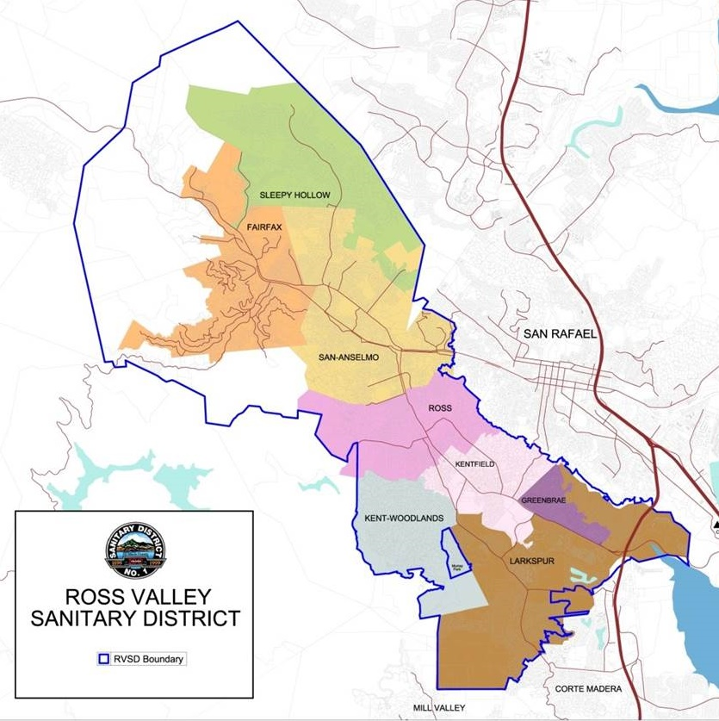
Ross Valley Service Area
55,000 customers (~15,000 connections)
Average dry weather flow: 5 mgd
Peak wet weather flow: 55 mgd
194 miles of gravity sewers
8.4 miles of force mains
19 pump stations

Slide 3
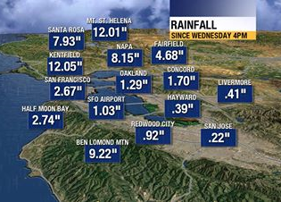
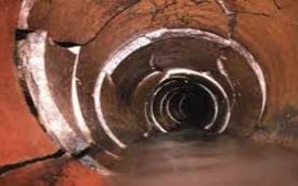
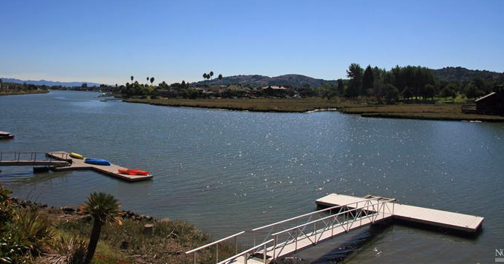

The district has many challenges
Aging Infrastructure & Deferred Maintenance
High Rainfall
Sensitive Environment
Funding and Rate Setting

Slide 4
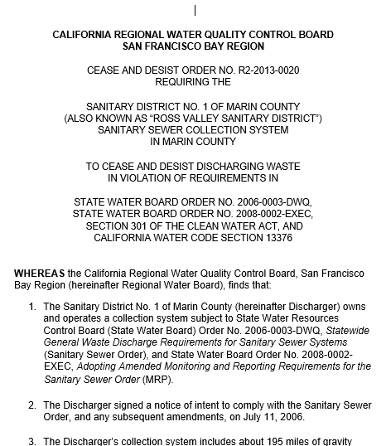
In addition, in May 2013 The district received a Cease and Desist Order
Required District to complete all historical capital improvements within 5 years
Price tag: > $100M
Fiscally infeasible
Did not promote asset management
Would have turned the entire community into a construction zone

Slide 5
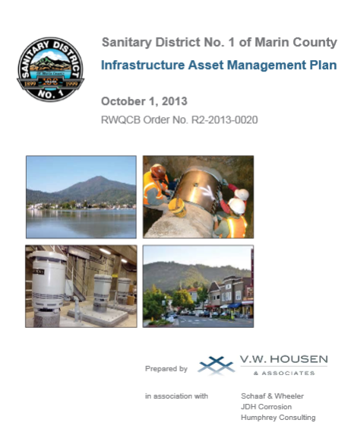
The RWQCB Agreed to an Infrastructure Asset Management Plan
Prioritized Needs to Rapidly Address Risk
Justified Fewer Projects Over a Longer Period
Gained Valuable Time Needed to Fine-Tune the Most Costly Projects
Builds In Flexibility to Adjust Priorities Based on Continued Assessments

Slide 6
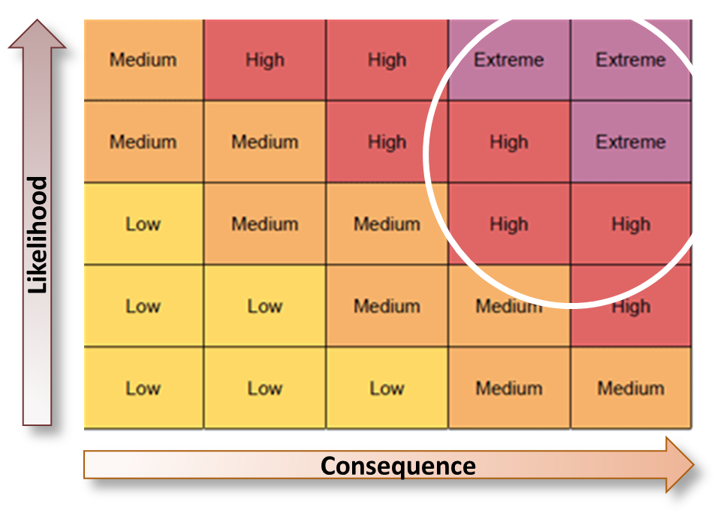
The cease and desist Order demanded Accelerated pipeline rehabilitation
The District Met This Challenge Using A Numerical Risk Management Tool

Slide 7
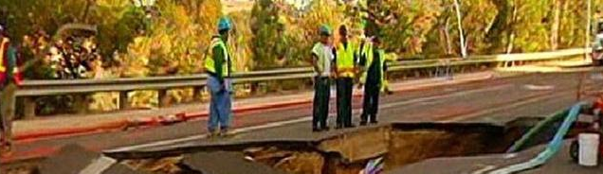
ASSET MANAGEMENT IS A FLUID AND PERPETUAL PROCESS
Understand your system and Level of Service objectives
Be diligent about extending useful life
Take action when an asset must be replaced to sustain the desired Level of Service

Slide 8
Using an asset management approach, Ross Valley gained control over the CIP
Capital Spending Using an Asset Management Approach
Capital Spending Using a Reactive Approach
Miles of Pipe
1980
2013
2025
2040
Approximate replacement schedule based on a 75-year service life

Slide 9
The risk model is designed to produce rapid results in SSO reduction
Risk Reduction Using the Risk Management Tool
Sewer
Management
Objectives
Risk Reduction Using “Business as Usual”
Reliability Objectives
Time

Slide 10
How the risk management tool works
Likelihood of Failure (from InfoNet CMMS)
Consequence of Failure (GIS Data)
Material (Techite)
Structural Condition
O&M Condition
Located in Bay Mud
Located in Landslide Zone
Capacity/SSOs
Maintenance Needs
Near Waterway
Near School, Park
Crosses Major Roadway
Serves Large Area
Risk Score for Every Pipe Segment

Slide 11
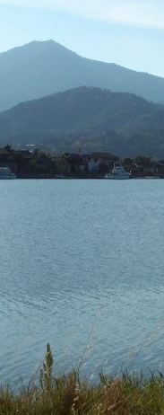
Level of Service Objectives form the basis for the risk model decision tree
Reliability – Make Sure the System Works
Environmental Protection – Protect Public Health and our Waterways
Community Impact – Keep the Sewers Invisible
Cost – Provide High Level of Service at the Lowest Sustainable Cost to the Community

Slide 12
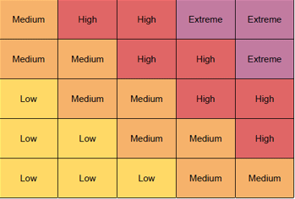
Infonet cmms provides critical information in the decision to renew or replace Pipelines
Preventive Maintenance Program
Repair or Replace
Real-Time Data
CMMS*
Managed Risk
* Computerized Maintenance
Management System

Slide 13
Raw cCTV data for half the system painted a serious picture
Red lines indicate at least one NASSCO PACP Structural Grade 4 or 5 Defect

Slide 14
Key question – do all of these defects need to be fixed now?
Answer is no …
GIS tools define the Consequence of Failure. Proximity to a waterway was the primary factor affecting replacement priorities.

Slide 15
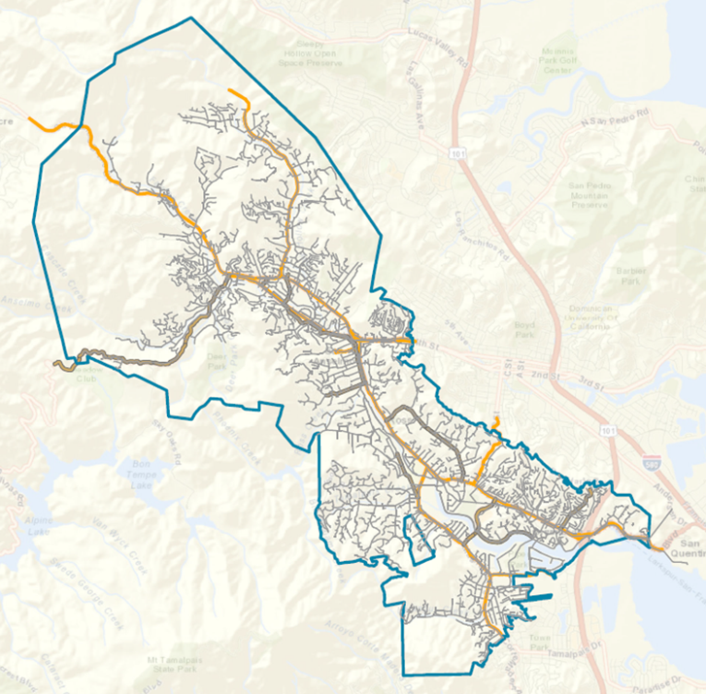
Critical Arterial Roadways are differentiated in the model as Primary and Secondary
If a pipe break would impact on a major transportation corridor, the pipe was elevated in criticality.

Slide 16
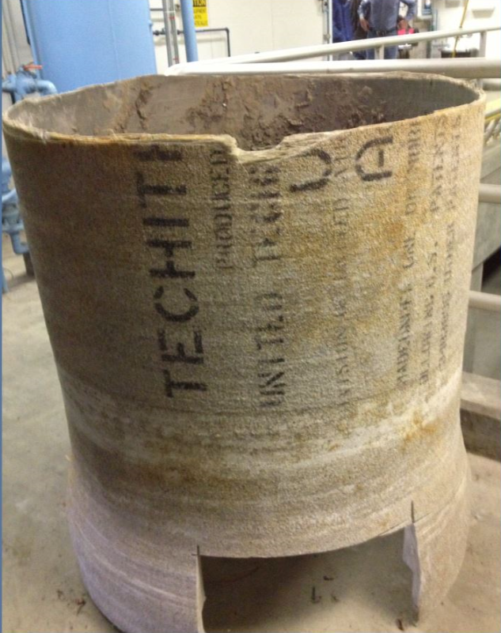
Other factors defined likelihood and consequence of failure
Techite
NASSCO PACP
Maintenance History
Geologic Features
Proximity to Parks or Schools
Area Served

Slide 17
Calibration of the risk model prevented overlapping criteria from skewing results
Each criteria carried an individual weight and score. Overlapping criteria were either weighted or grouped to control total criticality.
Landslide Zone
Parks
Schools
Bay Mud

Slide 18
Risk Tool Show that 10% of the system’s pipes contain the highest risk
Highest Risk Pipes Have PACP Str Gr5 or Techite plus..
High Consequence
Moderate Consequence
7%
Other Pipes Require
Re-inspection and Reassessment
3%
6%
36%
Many Pipes Require No Corrective Action
Inspection in
Process

Slide 19
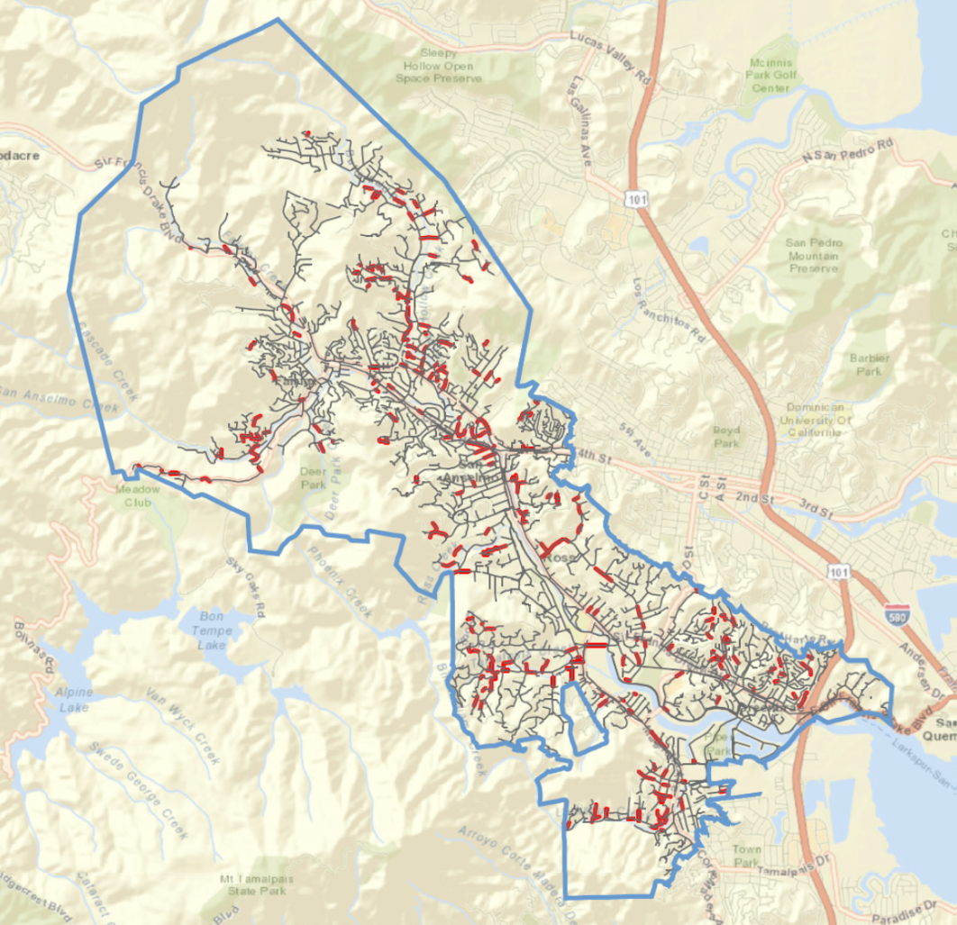
The Risk management Results painted a more strategic picture
Raw Scores
Risk Assessment

Slide 20
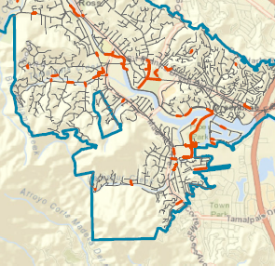
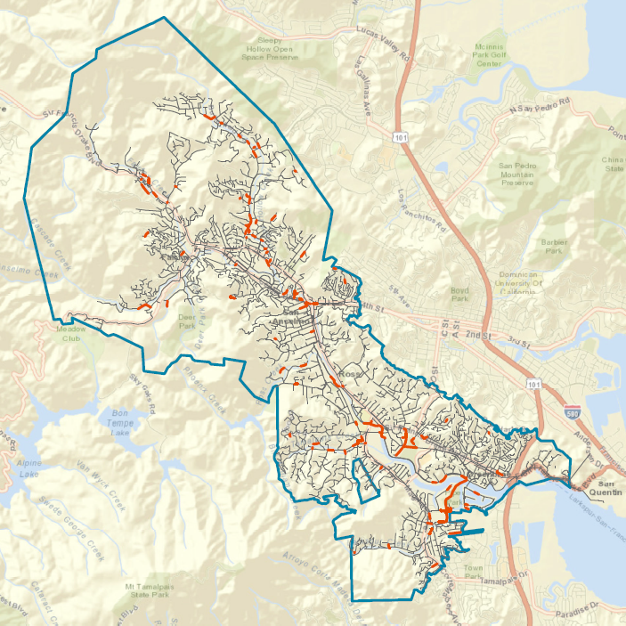
The Risk Model Also shows Us where the next group of issues may occur
These pipes have not failed, but are showing signs of aging and are in high consequence locations
Monitor closely during regular O&M activities

Slide 21
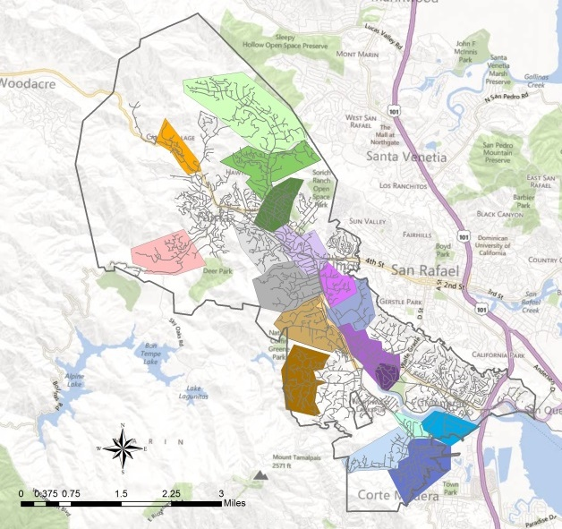
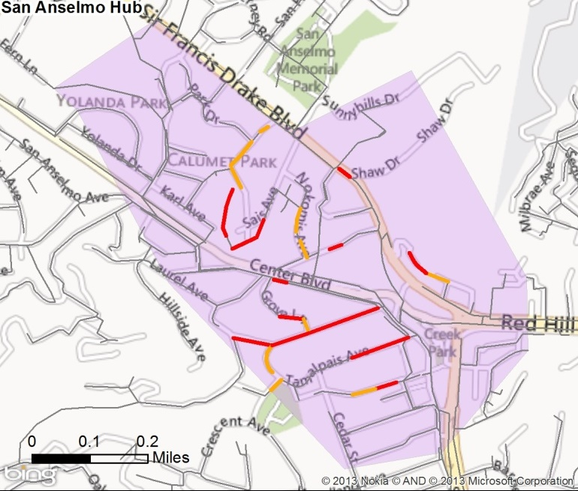
To focus the program further, the program used a surgical approach to repairs
1 or 2 Point Repairs
Pipe Replacement

Slide 22
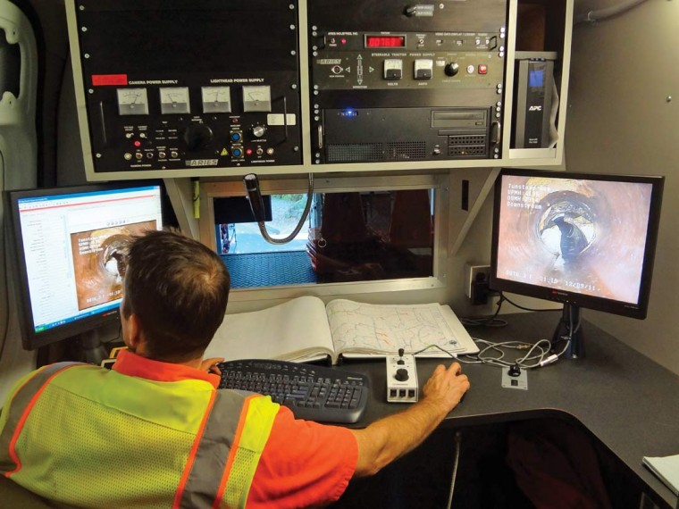
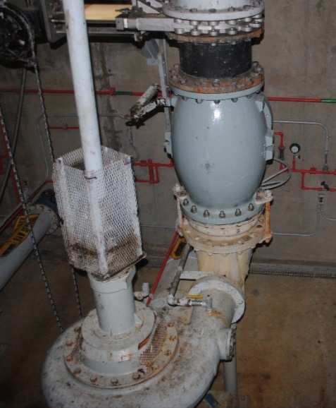
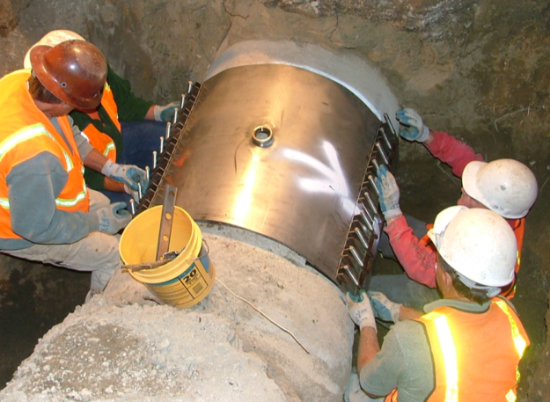
Linear asset management was one component of a multi-faceted program
Pump Stations Were Reviewed for:
Firm Capacity
Outage Reliability
Useful Life
O&M Activities Inform and Support Program Changes
RWQCB Agreed to Defer Costly Force Main Replacements Until Field Assessments are Completed

Slide 23
RESULTS!!
40 percent reduction in capital funding requirement
Highest priority items addressed first for early results
Regional Board reviewed and had minor comments – extended timeline and flexible approach were approved
RVSD is now well positioned for lifecycle asset management

Slide 24
Top five things to take away from this Presentation
Good data is critical to successful decisionmaking
About ten percent of the system presents the majority of risk
By addressing these ten percent, a high Level of Service can be achieved
Replacement costs can be controlled through a surgical approach to pipeline repairs
This approach has been accepted by the Regional Board

Slide 25
Enhancing Level of Service through risk-based asset management
Northern California Pipe User’s Group
February 20, 2014
Greg Norby, P.E.
gnorby@rvsd.org
Vivian Housen, P.E.
vhousen@housenassociates.com

